Slide 1
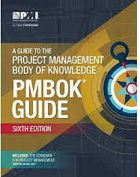
Software Project Management
6th Edition
Lecture 3
PM Knowledge Areas
Project Management Institute

Slide 2
PMI
PMI stands for the Project Management Institute, and is a not-for-profit professional membership association for project managers and program managers.
PMI was started in 1969, and now has a membership of more than 2.9 million professionals around the globe.
The Project Management Institute is the organization that gives out the PMP (Project Management Professional) credential, a globally recognized certificate that assures employers that a person is trained and qualified to manage projects.
PMI is also the organization that oversees the documentation of the Project Management Body of Knowledge (PMBOK) within the PMBOK Guide.

Slide 3
PMBOK
PMBOK stands for Project Management Body of Knowledge .
It is the entire collection of processes, best practices, terminologies, and guidelines that are accepted as standards within the project management industry.
Because the body of knowledge is constantly growing as practitioners discover new methods or best practices, it must be updated and disseminated.
This is an effort that is overseen by the Project Management Institute (PMI), the global not-for-profit member association of PM professionals which captures and publishes the PMBOK within the book, A Guide to the Project Management Body of Knowledge (PMBOK Guide).
The first edition of the PMBOK Guide was published in 1996. It is now on its sixth edition, which was published in 2017.
Notes:
49 processes, 10 knowledge areas

Slide 4
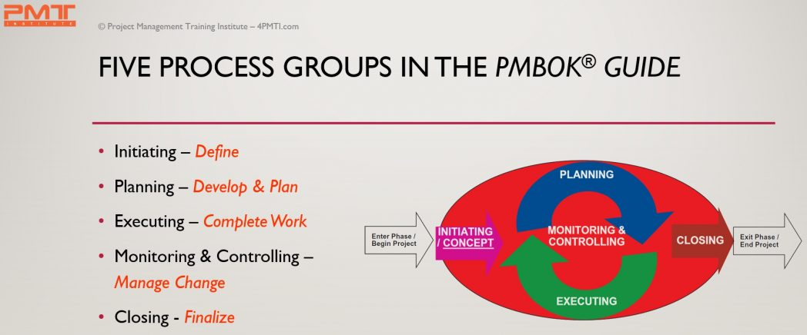
PMBOK Process Groups
Notes:
A process is a series of actions directed toward a particular result
Process groups and their constituent processes are guides for applying appropriate project management knowledge and skills during the project.’

Slide 5
PMBOK Process Groups
The initiating process group consists of processes necessary to define a new project or a new phase of an existing project
Involves obtaining authorization for the project or project phase
Defines objectives, outcomes, and success criteria
Assigns a Project Manager (usually)
Allocates funds and resources

Slide 6
PMBOK Process Groups
There are several key outputs that are produced as part of the initiation process group. These are the:
Project Charter
Feasibility Study
Stakeholder-related documents (stakeholder list, stakeholder management plan).

Slide 7
PMBOK Process Groups
The planning process group involves
Defining the scope of the project
Designing the course of action required to achieve the project’s objectives
Defining the products to be produced and work required
Sequencing work and creating a schedule
Estimating the resource and effort requirements
Estimating costs and creating a budget

Slide 8
PMBOK Process Groups
The key outputs of the planning process group are the
Project Management Plan
Work Breakdown Strzcsucture (WBS)
Schedule
Budget

Slide 9
PMBOK Process Groups
The executing process group involves:
Establishing and managing the project team
Coordinating people and resources
Monitoring team performance
Contracting procurements
Directing and managing project execution
Distributing information
Performing quality assurance activities

Slide 10
PMBOK Process Groups
The main outputs of this process group are:
The risk and issue management responses plus corrective and preventative actions
The deliverables themselves plus work performance information
Change requests with regards to utilization and effectiveness of the quality plan
Negotiation and influence to ensure appropriate staff are assigned
Motivation building and mentoring to ensure the team performance
Conflict resolution and problem solving
Procurements and contracts are negotiated and put in place

Slide 11
PMBOK Process Groups
The Monitoring & Controlling Process Group
Involves tracking, reviewing, and regulating project progress
Includes status reporting, progress measurement, and forecasting
Reports on scope, schedule, cost, resources, quality, and risks
Controls project and project document changes Includes control of scope, schedule, costs, and risks
Records quality control results
Implements risk treatment plans and actions
Administers procurements

Slide 12
PMBOK Process Groups
The key outputs are
Progress and status reports
Plan updates
Risks registers
Change requests
Work products/deliverables

Slide 13
PMBOK Process Groups
The key activities for the closing process group are
Obtaining acceptance by the customer or sponsor (approval to close)
Releasing people and resources
Reporting on team performance and lessons learned
Updating or finalizing documents, project records, and results
Finalizing procurements
Performing quality assurance activities
Storing or archiving information

Slide 14
PMBOK Process Groups
The key outputs of this group are
Certificate of Completion/Closeout Report
Staff work assignments
Resource calendars
Plan updates
Final work products/deliverables or services

Slide 15
PMBOK Knowledge Areas
The ten knowledge areas are the skills a project manager must practice and master to manage a project efficiently.
Main activities of each process group can be mapped into the Ten knowledge areas using the PMBOK® Guide 2017.

Slide 16
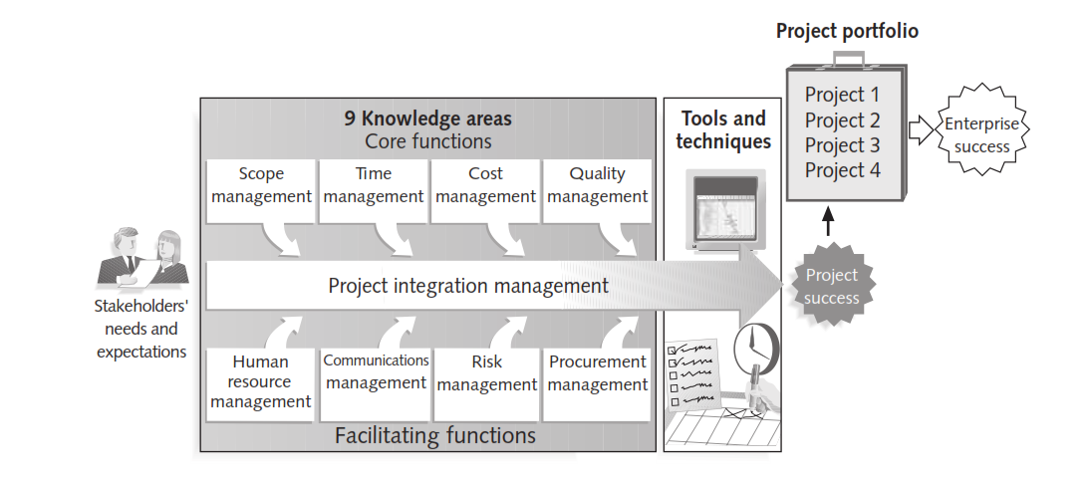
PMI Knowledge Areas
Project Management Knowledge Area: An identified area of project management defined by its knowledge requirements and described in terms of its component processes, practices, inputs, outputs, tools, and techniques.
Notes:
Project Managers must not only strive to meet specific scope, time, cost and quality goals of projects, they must also facilitate the entire process to meet the needs and expectations of the people involved in or effected by project activities.

Slide 17
Overview of Knowledge Areas
Scope
Integration
Human Resources
Communications
Risk
Procurement
Stakeholder management
Cost
Time
Quality

Slide 18
PMBOK Knowledge Areas
Project Integration Management:
The knowledge area which is devoted to identify and define the work in the project is known as the Integration Management.
This knowledge area also deals with efficiently integrating changes into the project.
Includes the processes and activities to identify, define, combine, unify, and coordinate the various processes and project management activities within the Project Management Process Groups.

Slide 19
PMBOK Knowledge Areas
Project Integration Management:
The project Integration management processes are:
Develop Project Charter—The process of developing a document that formally authorizes the existence of a project and provides the project manager with the authority to apply organizational resources to project activities.
Develop Project Management Plan—The process of defining, preparing, and coordinating all subsidiary plans and integrating them into a comprehensive project management plan.
Direct and Manage Project Work—The process of leading and performing the work defined in the project management plan and implementing approved changes to achieve the project's objectives.
Monitor and Control Project Work—The process of tracking, reviewing, and reporting project progress against the performance objectives defined in the project management plan.
Perform Integrated Change Control—The process of reviewing all change requests; approving changes and managing changes to deliverables, organizational process assets, project documents, and the project management plan; and communicating their disposition.
Close Project or Phase—The process of finalizing all activities across all of the Project Management Process Groups to formally complete the phase or project.

Slide 20
PMBOK Knowledge Areas
Project Scope Management
This knowledge area deals with defining the project scope, project requirement scope, project work, making the work breakdown structure, making the scope baselines and managing the scope of the project.
This is one point where you can plan the ways of keeping the project within the established boundaries.
Encompasses the processes required to ensure the project includes all the work required, and only the work required, to complete the project successfully.
Notes:
This process is essential to ensure that the project includes all the necessary work while excluding any unnecessary work.
A scope baseline is an approved version of your project scope, which is documented in a scope statement, work breakdown structure (WBS) and WBS dictionary.
The scope baseline is used as a reference to monitor project progress and compare actual versus planned results.
A WBS dictionary is where the details of the tasks, activities, and deliverables of the work breakdown structure are located.

Slide 21
PMBOK Knowledge Areas
Project Scope Management
The project scope management processes are:
Plan Scope Management—The process of creating a scope management plan that documents how the project scope will be defined, validated, and controlled.
Collect Requirements—The process of determining, documenting, and managing stakeholder needs and requirements to meet project objectives.
Define Scope—The process of developing a detailed description of the project and product.
Create WBS—The process of subdividing project deliverables and project work into smaller, more manageable components.
Validate Scope—The process of formalizing acceptance of the completed project deliverables.
Control Scope—The process of monitoring the status of the project and product scope and managing changes to the scope baseline.

Slide 22
PMBOK Knowledge Areas
Project Time Management:
The project managers estimate the duration of the tasks in this knowledge area.
This is where the project manager sequences the tasks and chooses the number of resources required to achieve the objectives of the project.
Schedule is monitored and managed here in this area to keep the project on the track.
Includes the processes required to manage the timely completion of the project.

Slide 23
PMBOK Knowledge Areas
Project Time Management:
The project time management processes are:
Plan schedule management.
Define Activities: Process of identifying and documenting the specific actions.
Sequence Activities: Process of identifying and documenting relationships.
Estimate Activity Resources: Process of estimating the type and quantities of material, human resources, equipment, or supplies.
Estimate Activity Durations: Process of estimating the number of work periods.
Develop Schedule: Process of analyzing activity sequences, durations, resource requirements, and schedule constraints.
Control Schedule: Process of monitoring the status of project activities.

Slide 24
PMBOK Knowledge Areas
Project Cost Management:
Budget baseline is established and costs are estimated in this knowledge area.
The plan to manage the costs is categorized in the cost management knowledge area too.
Includes the processes involved in planning, estimating, budgeting, financing, funding, managing, and controlling costs so the project can be completed within the approved budget.

Slide 25
PMBOK Knowledge Areas
Project Cost Management:
The project cost management processes are:
Plan Cost Management—The process that establishes the policies, procedures, and documentation for planning, managing, expending, and controlling project costs.
Estimate Costs—The process of developing an approximation of the monetary resources needed to complete project activities.
Determine Budget—The process of aggregating the estimated costs of individual activities or work packages to establish an authorized cost baseline.
Control Costs—The process of monitoring the status of the project to update the project costs and managing changes to the cost baseline.

Slide 26
PMBOK Knowledge Areas
Project Quality Management:
It is the knowledge area where the quality requirements for project deliverables are planned and tracked.
In this area, all the quality issues are monitored and fixed.
Includes the processes for incorporating the organization's quality policy regarding planning, managing, and controlling project and product quality requirements, in order to meet stakeholders’ expectations.

Slide 27
PMBOK Knowledge Areas
Project quality Management:
The project quality management processes are:
Plan Quality Management—The process of identifying quality requirements and/or standards for the project and its deliverables and documenting how the project will demonstrate compliance with quality requirements.
Perform Quality Assurance—The process of auditing the quality requirements and the results from quality control measurements to ensure that appropriate quality standards and operational definitions are used.
Control Quality—The process of monitoring and recording results of executing the quality activities to assess performance and recommend necessary changes.

Slide 28
PMBOK Knowledge Areas
Project Human Resources Management:
This knowledge area, which is the HR management of the project.
It comprises of the processes very essential to define the ways human resources will be utilized, developed, acquired and managed.
Includes the processes to identify, acquire, and manage the resources needed for the successful completion of the project.

Slide 29
PMBOK Knowledge Areas
Project human Management:
The project human management processes are:
Plan Human Resource Management—The process of identifying and documenting project roles, responsibilities, required skills, reporting relationships, and creating a staffing management plan.
Acquire Project Team—The process of confirming human resource availability and obtaining the team necessary to complete project activities.
Develop Project Team—The process of improving competencies, team member interaction, and overall team environment to enhance project performance.
Manage Project Team—The process of tracking team member performance, providing feedback, resolving issues, and managing changes to optimize project performance.

Slide 30
PMBOK Knowledge Areas
Project Communications Management:
Communications management is the knowledge area that defines how communications within the project will work.
In these processes, the project manager makes the communication management plan, ensures the plan is followed, and controls information flow within the project.
Includes the processes required to ensure timely and appropriate planning, collection, creation, distribution, storage, retrieval, management, control, monitoring, and ultimate disposition of project information.

Slide 31
PMBOK Knowledge Areas
Project Communications Management:
The project Communications management processes are:
Plan Communications Management—The process of developing an appropriate approach and plan for project communications based on stakeholder's information needs and requirements, and available organizational assets.
Manage Communications—The process of creating, collecting, distributing, storing, retrieving and the ultimate disposition of project information in accordance with the communications management plan.
Control Communications—The process of monitoring and controlling communications throughout the entire project life cycle to ensure the information needs of the project stakeholders are met.

Slide 32
PMBOK Knowledge Areas
Project Risk Management:
Project Risk Management consists of identifying risks, planning risk management, conducting risk assessments, and controlling risks.
Project Risk Management includes the processes of conducting risk management planning, identification, analysis, response planning, response implementation, and monitoring risk on a project.
Notes:
A risk response plan is a document that explains the strategies that would be taken to mitigate negative project risks.

Slide 33
PMBOK Knowledge Areas
Project Risk Management:
The project Risk management processes are:
Plan Risk Management—The process of defining how to conduct risk management activities for a project.
Identify Risks—The process of determining which risks may affect the project and documenting their characteristics.
Perform Qualitative Risk Analysis—The process of prioritizing risks for further analysis or action by assessing and combining their probability of occurrence and impact.
Perform Quantitative Risk Analysis—The process of numerically analyzing the effect of identified risks on overall project objectives.
Plan Risk Responses—The process of developing options and actions to enhance opportunities and to reduce threats to project objectives.
Control Risks—The process of implementing risk response plans, tracking identified risks, monitoring residual risks, identifying new risks, and evaluating risk process effectiveness throughout the project.

Slide 34
PMBOK Knowledge Areas
Project Procurement Management:
This knowledge area deals with the processes which project managers usually follow to acquire required material for the successful completion of the project.
In this knowledge area, project managers come up with the plan for conducting procurements, controlling the procurements and closing out the procurements.
Project Procurement Management includes the processes necessary to purchase or acquire products, services, or results needed from outside the project team.

Slide 35
PMBOK Knowledge Areas
Project Procurement Management:
The project procurement management processes are:
Plan Procurement Management—The process of documenting project procurement decisions, specifying the approach, and identifying potential sellers.
Conduct Procurements—The process of obtaining seller responses, selecting a seller, and awarding a contract.
Control Procurements—The process of managing procurement relationships, monitoring contract performance, and making changes and corrections as appropriate.
Close Procurements—The process of completing each project procurement.

Slide 36
PMBOK Knowledge Areas
Project Stakeholder Management:
Project Stakeholder Management area encompasses all the processes which is used by a project manager for recognizing and satisfying the ones who are affected by the project.
The affected party can either be internal or external, in nature.
You can pay close attention to those stakeholders who can have a powerful positive or negative impact on the project.

Slide 37
PMBOK Knowledge Areas
Project Stakeholders Management:
The project stakeholders management processes are:
Identify Stakeholders—The process of identifying the people, groups, or organizations that could impact or be impacted by a decision, activity, or outcome of the project; and analyzing and documenting relevant information regarding their interests, involvement, interdependencies, influence, and potential impact on project success.
Plan Stakeholder Management—The process of developing appropriate management strategies to effectively engage stakeholders throughout the project life cycle, based on the analysis of their needs, interests, and potential impact on project success.
Manage Stakeholder Engagement—The process of communicating and working with stakeholders to meet their needs/expectations, address issues as they occur, and foster appropriate stakeholder engagement in project activities throughout the project life cycle.

Slide 38
PMBOK Knowledge Areas
Project Stakeholder Management:
Monitoring Stakeholder Engagement - In this process, the project manager should monitor stakeholders’ relationships and tailor strategies for engaging stakeholders via modification strategies and plans. Furthermore, monitoring stakeholder engagement helps the project manager enhance the efficiency and productiveness of stakeholder engagement activities. As well as this process is performed throughout the project life cycle.

Slide 39
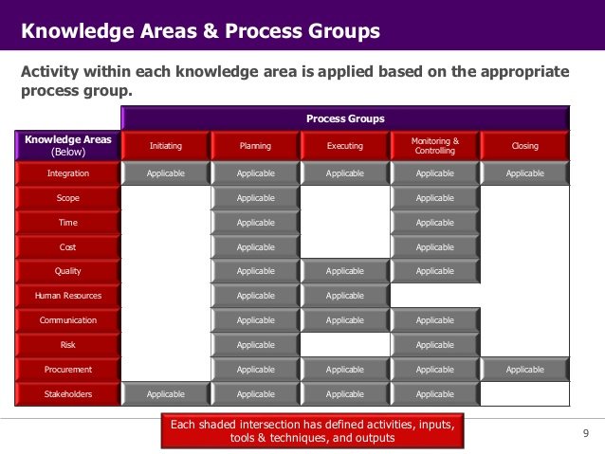
Knowledge Areas and Process Groups

Slide 40
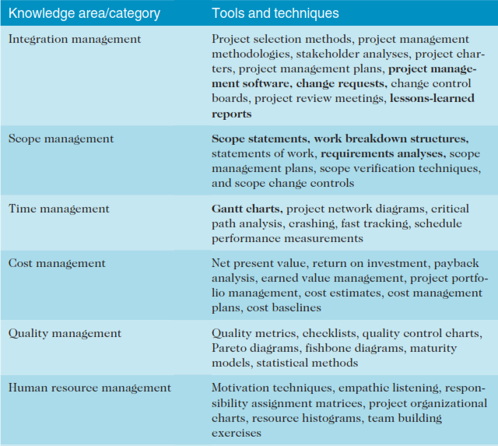
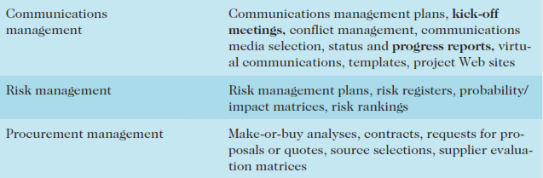
Tools & Techniques by Knowledge Area

Slide 41
The Integration Challenge Software Product Development Example
Proposal Request
Overlapped phases can yield cost and schedule benefits but add to the integration challenge
Proposal Phase
Requirements Analysis Phase
General Design Phase
Detailed Design Phase
Code and Debug

Slide 42
Characteristics of Effective Integration
Overlapped processes
Effective change control and communication systems
Reduced development time and cost
Early and ongoing involvement of all stakeholders
Early visibility of results
Early problem identification and resolution
Use all relevant expertise at earliest meaningful time

Slide 43
Remodel Kitchen WBS
Remodel Kitchen
Level 1
Design
Purchase
Carpentry
Electrical
Purchase
Appliances
Purchase
Fixtures
Level 2

Slide 44
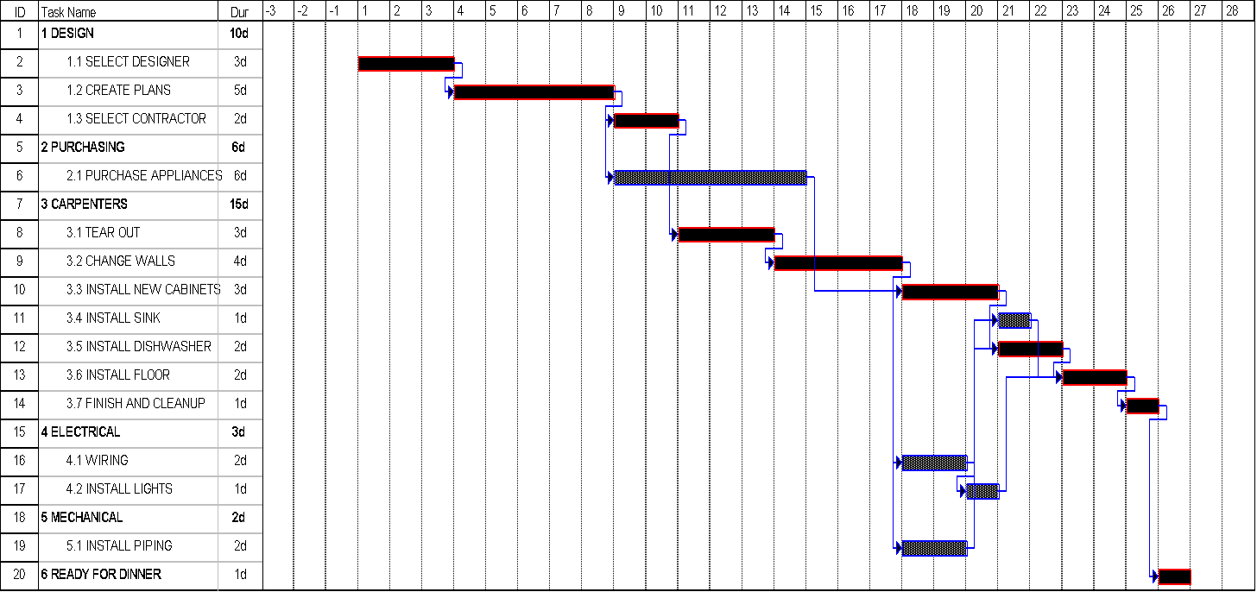
Kitchen Remodeling Precedence Relationships

Slide 45
One Performance Measurement
Earned Value
Budgeted Cost of Work Performed (BCWP)
Related Terms
Budgeted Cost of Work Scheduled (BCWS)
Actual Cost of Work Performed (ACWP)
Budget at Completion (BAC)
Notes:
To illustrate the difference between the three terms, assume that a schedule contains a task "Test hardware" estimated to run from 1 January to 10 January and to cost $1000, and that this is a simple effort with no overhead or allocated costs. However on 5 January, halfway through the time allowed, the work is 30% complete and has spent $250.
BCWP is $1000 (budgeted cost) times 30% (work performed), or $300
BCWS is $1000 (budgeted cost) times 50% (scheduled amount), or $500
ACWP is $250

Slide 46
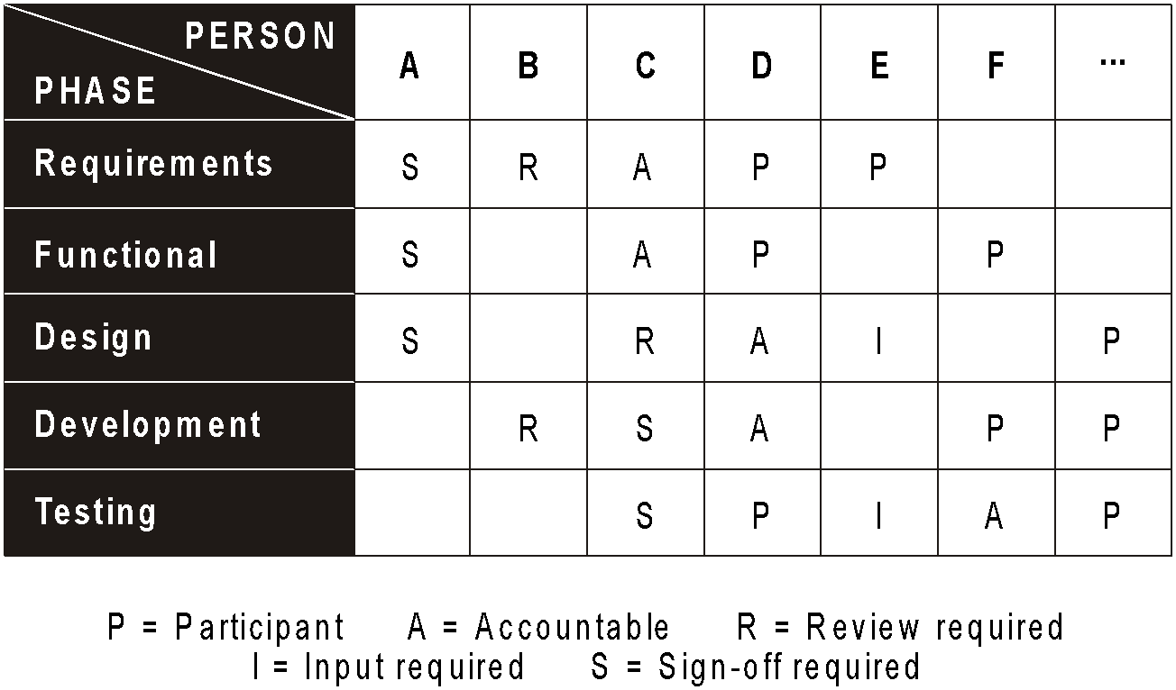
Responsibility Chart

Slide 47
Responsibility Chart Characteristics
Work Package Level
Components
WBS activity
Responsible organization
Responsible position title or person
Type of responsibility
Approving authority
Prime implementation accountability
Support
Notification
Notes:
The work package level is the lowest level of a work breakdown structure (WBS).

Slide 48
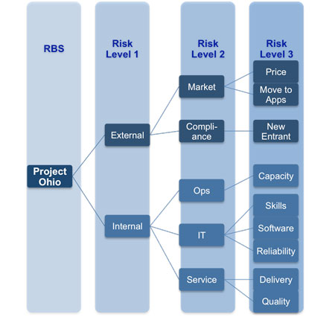

Slide 49
Technical Fundamentals
Requirements
Analysis
Design
Construction
Quality Assurance
Deployment
For details refer to slide 12,13,14,15 of Lecture 1

Slide 50
Project Phases
All projects are divided into phases
All phases together are known as the Project Life Cycle
Each phase is marked by completion of Deliverables
Identify the primary software project phases

Slide 51
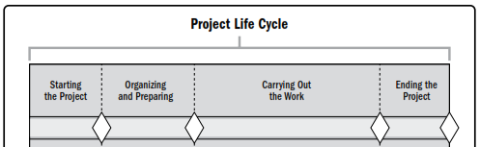
Project Life cycle
Project Life Cycle: The series of phases that a project passes through from its start to its completion.
Project Phase: A collection of logically related project activities that culminates in the completion of one or more deliverables.
Phase Gate: A review at the end of a phase in which a decision is made to continue to the next phase, to continue with modification, or to end a program or project.
Notes:
Phases are the Logical Division of a project. Work being carried out in each phase has a distinct focus i.e. producing detailed design and drawing requirements during design phase, Procurement during construction phase and producing documentation for possession during occupancy phase.
Each phase has its own objectives and deliverables. i.e. deliverable for Design phase is bill of quantities etc.
When a phase is formally closed it called Stage gate, Phase gate, Milestone or kill point. Review of phase being closed and decision to move to next phase is made during phase closure.

Slide 52
Project and Development Life cycles
Within a project life cycle, there are generally one or more phases that are associated with the development of the product, service, or result. These are called a development life cycle. Development life cycles can be predictive, iterative, incremental, adaptive, or a hybrid model:
In a predictive life cycle, the project scope, time, and cost are determined in the early phases of the life cycle. Any changes to the scope are carefully managed. Predictive life cycles may also be referred to as waterfall life cycles.
In an iterative life cycle, the project scope is generally determined early in the project life cycle, but time and cost estimates are routinely modiﬁed as the project team’s understanding of the product increases. Iterations develop the product through a series of repeated cycles, while increments successively add to the functionality of the product.
Notes:
It's also known as a "waterfall" or "plan-driven" approach because the project progresses in a linear, sequential manner through predefined phases, from start to finish.
Key characteristics of a predictive life cycle:
Fixed Scope: The project’s requirements and deliverables are clearly defined from the beginning, and changes are minimized.
Detailed Planning: A comprehensive project plan is created early, outlining all phases, tasks, timelines, and resources.
Linear Progression: Each phase must be completed before the next one begins. For example, once planning is complete, the team moves to execution without revisiting previous phases.
Emphasis on Control: This approach is used when the project is well-understood, and changes are not expected, allowing for greater control over the process.
Difficulty Adapting to Change:
The fixed nature of the scope and plan means it’s hard to accommodate changes in requirements once the project is underway. This can be problematic in dynamic industries where client needs or market conditions change frequently.
Inaccurate Initial Planning:
Since most of the planning happens early in the project, inaccurate estimates in cost, time, or resources can lead to significant problems later on. If unexpected issues arise, they can cause delays and budget overruns.
Late Discovery of Problems:
In a linear, sequential approach, problems or defects may only be discovered in later stages, which can be more costly to fix. For example, a flaw in design might not be noticed until testing or implementation, leading to rework.
Limited Customer Feedback:
Predictive life cycles often involve limited interaction with stakeholders after the initial planning phase. Without regular feedback, the final deliverable might not meet the client’s needs, especially if those needs evolve during the project.
Reduced Flexibility:
The rigid structure of the predictive approach makes it hard to respond quickly to new opportunities or challenges. Projects in fast-changing industries may suffer from the lack of flexibility.
High Risk of Project Failure:
If early assumptions about requirements, market conditions, or technical specifications are wrong, the entire project can veer off course, sometimes leading to project failure or significant delays.
Longer Delivery Time:
Since the deliverable is usually only provided at the end of the project, stakeholders may have to wait a long time before seeing any results, which can be a drawback, especially in fast-paced environments.
The iterative life cycle is a project management approach where the project is developed in small, repeated cycles or iterations. Each iteration produces a working version of the product that improves or builds upon the previous one. The focus is on gradually refining and evolving the product based on feedback and learning from earlier iterations.
Key characteristics of an iterative life cycle:
Incremental Progress: Instead of delivering the final product at once, the project is broken down into smaller parts, with each iteration producing a usable version of the product.
Repeated Cycles: The process is repeated multiple times, with each cycle focusing on improving the product or addressing issues found in previous iterations.
Feedback-Driven: Feedback from stakeholders and users is collected after each iteration, and this input is used to refine the product in the next cycle.
Flexible Requirements: Project requirements can evolve over time. This flexibility allows the team to adapt to changes as they go through the cycles.
Example of an Iterative Life Cycle:
In software development, an iterative life cycle might involve building a simple version of an application in the first iteration, gathering feedback from users, and then enhancing the app with additional features or fixes in subsequent iterations.
Advantages:
Early Detection of Issues: Problems or areas for improvement are discovered early in the process, allowing for quicker fixes.
Stakeholder Engagement: Regular feedback helps ensure that the final product aligns with stakeholder expectations.
Flexibility: The project can adapt to changes in requirements, market conditions, or technology.
Risk Reduction: Risks are identified and mitigated earlier since the product evolves gradually, not all at once.
Challenges:
Scope Creep: As requirements can change with each iteration, there's a risk of the project growing beyond the original scope.
Complex Management: Managing multiple iterations and ensuring each builds properly on the last can be more complex than following a linear plan.
Time Pressure: Short iteration cycles might lead to pressure on the team to deliver frequent updates.

Slide 53
Project and Development Life cycles
In an incremental life cycle, the deliverable is produced through a series of iterations that successively add functionality within a predetermined time frame. The deliverable contains the necessary and sufﬁcient capability to be considered complete only after the ﬁnal iteration.
Adaptive life cycles are agile, iterative, or incremental. The detailed scope is deﬁned and approved before the start of an iteration. Adaptive life cycles are also referred to as agile or change-driven life cycles.
A hybrid life cycle is a combination of a predictive and an adaptive life cycle. Those elements of the project that are well known or have ﬁxed requirements follow a predictive development life cycle, and those elements that are still evolving follow an adaptive development life cycle.
Notes:
The incremental life cycle is a project management approach where the project is divided into small, manageable sections or increments, with each increment delivering a portion of the final product. Each increment is a working, functional part of the product, and as more increments are completed, the project gradually evolves into the final product.
Key characteristics of an incremental life cycle:
Step-by-Step Delivery: The project is broken down into smaller pieces, with each part delivered separately. Each increment adds functionality or features to the overall product.
Functional Increments: Every increment is a usable part of the product, even though it may not represent the full system.
Cumulative Progress: The product grows piece by piece, with each new increment building on what was delivered before.
Advantages:
Early Delivery of Value: Stakeholders get working parts of the project early, which can provide value even before the full project is completed.
Lower Risk: Problems can be addressed incrementally, reducing the chance of major issues at the end of the project.
Better Stakeholder Feedback: Since parts of the product are delivered early, feedback can be collected sooner and applied to future increments.
Flexibility in Prioritization: Important features can be prioritized and delivered first, ensuring high-value elements are completed early.
Challenges:
Integration Complexity: As more increments are added, integrating them smoothly can become challenging.
Incomplete Product Early On: Early increments may be functional but lack key features, which might not satisfy all stakeholder expectations until the final product is complete.
Potential for Scope Creep: Continuous addition of new features or increments may lead to changes in the original project scope, causing delays or budget overruns.
The adaptive life cycle is a project management approach that emphasizes flexibility and continuous adaptation to change. It is commonly associated with Agile methodologies and is used when the project scope or requirements are not fully defined at the start, or when they are likely to evolve throughout the project.
Key characteristics of an adaptive life cycle:
Iterative and Incremental: The project is delivered in small, workable increments, and each increment is refined through multiple iterations.
High Flexibility: The plan is adaptable, and changes to scope, priorities, or requirements are welcomed even late in the process.
Frequent Feedback: Stakeholder feedback is collected frequently (often after each iteration) and used to shape future work.
Collaborative: There is close collaboration between the project team and stakeholders to ensure the product meets evolving needs.
Short Iterations: Work is completed in short cycles (e.g., sprints in Agile), often lasting two to four weeks.
Advantages:
Adaptability to Change: The project can easily accommodate changes in requirements, making it ideal for projects where uncertainty is high.
Continuous Improvement: With frequent iterations and feedback, the product evolves and improves with each cycle.
Early Delivery of Value: Usable portions of the product are delivered early and often, allowing stakeholders to benefit from the project before it is fully completed.
Enhanced Collaboration: Ongoing communication between the team and stakeholders ensures that the project remains aligned with expectations.
Challenges:
Scope Creep: The high level of flexibility may lead to uncontrolled changes, causing delays or overruns in cost.
Complex Management: Constant adaptation and frequent changes require strong coordination and project management to avoid confusion or wasted effort.
Unclear End Point: Because requirements may evolve over time, it can be difficult to define when the project is “complete.
When to Use the Adaptive Life Cycle:
When requirements are not fully known at the start or are expected to change frequently.
When innovation or experimentation is needed.
In fast-moving industries, such as software development, where quick adaptation to new technology or market changes is critical.
A hybrid approach in project management combines elements of both predictive (traditional, plan-driven) and adaptive (Agile, flexible) life cycles to create a tailored process that meets the unique needs of a project.
Combination of Methodologies: It blends predictive techniques for well-defined tasks (like planning and risk management) with adaptive methods for parts of the project that require flexibility and frequent iterations.Structured Phases with Flexibility: Some phases of the project, like planning or resource allocation, follow a structured, predictive approach, while others, like product development or prototyping, follow an iterative and incremental process.Selective Application: Different parts of the project can use different approaches. For example, stable parts (like infrastructure) might use predictive methods, while innovative parts (like software features) follow Agile.
Example of a Hybrid Approach:
In a construction project that includes the development of a custom software system:
Predictive for Construction: The building’s construction follows a detailed, fixed plan with strict deadlines, cost estimates, and scope (since changes are expensive and difficult to manage).
Adaptive for Software: The software system is developed using an Agile approach, allowing flexibility in adding or modifying features based on feedback as the project progresses.
Advantages:
Flexibility with Control: The hybrid approach allows for adaptability where needed, while maintaining structure and predictability in other areas.
Best of Both Worlds: It combines the benefits of detailed upfront planning with the ability to adapt to changes throughout the project, which helps mitigate risks.
Better Stakeholder Management: Stakeholders can see early results in adaptive portions while still having the assurance that critical, stable parts of the project are being managed predictively.
Custom Fit for Complex Projects: Projects that involve different types of work (e.g., hardware and software) benefit from a hybrid approach because it aligns different phases with the most suitable methodology.
Challenges:
Complex Integration: Managing a project that uses multiple methodologies can be more complex, requiring clear communication and coordination between teams working on different phases.
Inconsistent Approaches: The transition between adaptive and predictive methods can cause confusion if not managed well, particularly in terms of timelines, responsibilities, and expectations.
Resource Management: Allocating resources effectively between teams following different processes can be tricky, especially if both methodologies require different types of oversight or skills.
When to Use the Hybrid Approach:
In projects where some aspects are well-defined and predictable (e.g., regulatory requirements), but others are subject to change (e.g., customer preferences or market demands).
When both innovation and control are necessary.
In industries where both physical products (predictive) and software (adaptive) are developed in parallel.

Slide 54
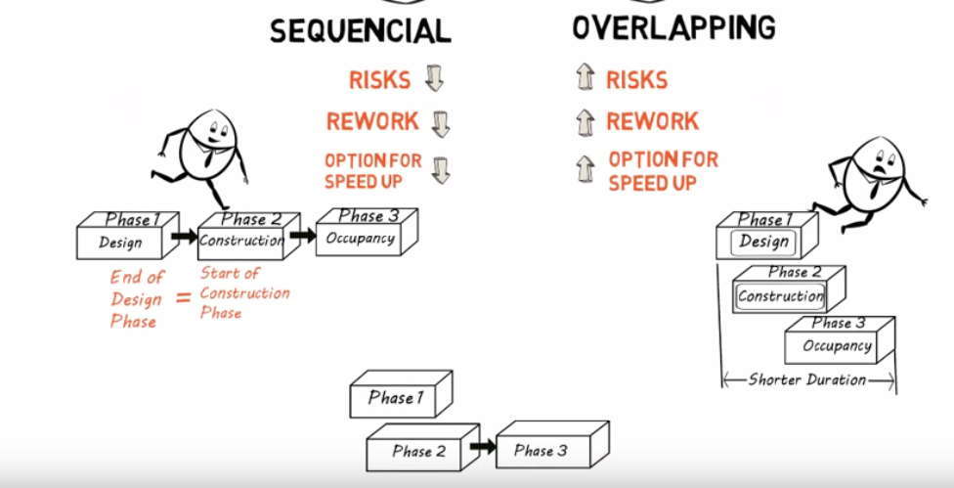
A comparison

Slide 55
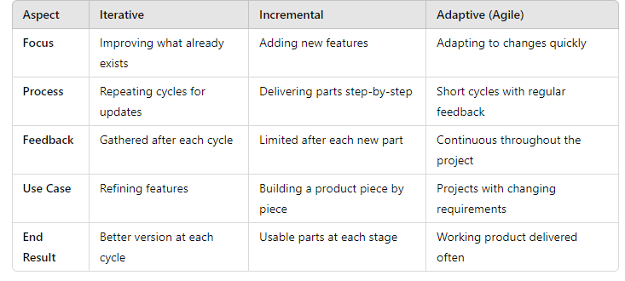
Comparison

Slide 56
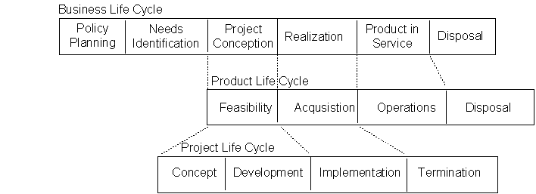
Lifecycle Relationships
Notes:
Project Scope and Product Scope are two important concepts in project management, but they refer to different aspects of a project. Here’s a breakdown of the differences:
Project Scope
Definition: Project scope refers to the specific work and tasks that need to be completed to deliver the project successfully. It outlines the boundaries of the project, including what is included and what is excluded.
Focus: It focuses on the project’s processes, resources, and timelines. It details how the project will be executed, managed, and controlled.
Components:
Tasks to be performed
Resources needed (people, tools, materials)
Timeframe for completion
Project constraints and assumptions
Example: In a construction project, the project scope might include the design, procurement of materials, and construction of the building, specifying tasks like site preparation, foundation work, and utility installation.
Product Scope
Definition: Product scope refers to the features, functions, and characteristics of the final product or service that is being delivered. It defines what the product is, its specifications, and its intended quality.
Focus: It focuses on what the end product will look like and what it will do. It is about meeting user needs and requirements.
Components:
Features and functionalities of the product
Quality requirements
Specifications and standards
Example: In the same construction project, the product scope would detail the specifications of the building, such as the number of floors, materials used, layout, and amenities (like parking spaces and landscaping).

Slide 57
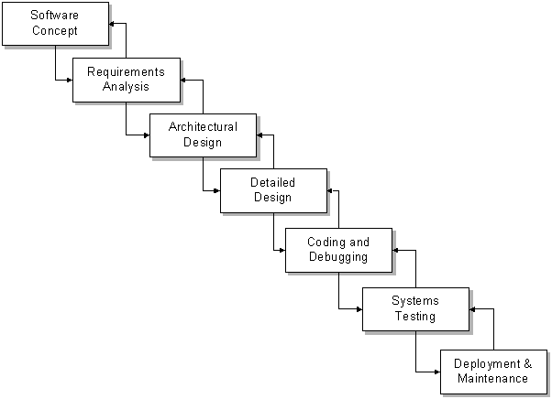
Seven Core Project Phases

Slide 58
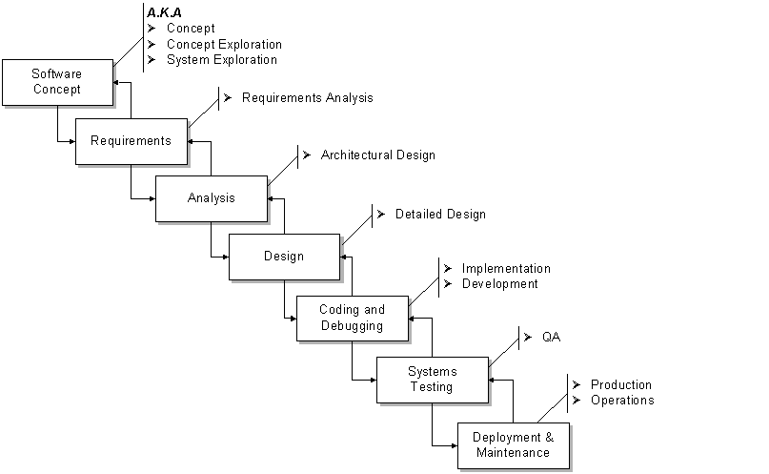
Project Phases A.K.A.

Slide 59
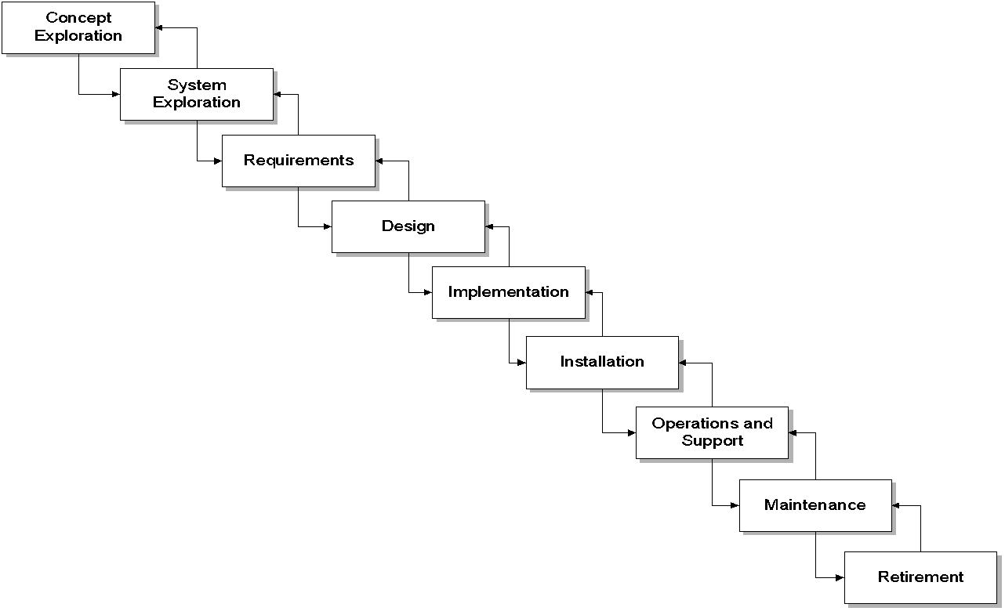
Phases Variation
Notes:
one size SLC cannot possibly fit all.
unique projects require unique models, or combinations of models, to succeed.

Slide 60
Why Rapid Development
Faster delivery
Reduced risk
Increased visibility to customer
Don’t forsake quality

Slide 61
Strategy
Classic Mistake Avoidance
Apply Development Fundamentals
Risk Management
Apply Schedule-Oriented Practices
Notes:
McConnell refers to “Pillars”
These provide balance

Slide 62
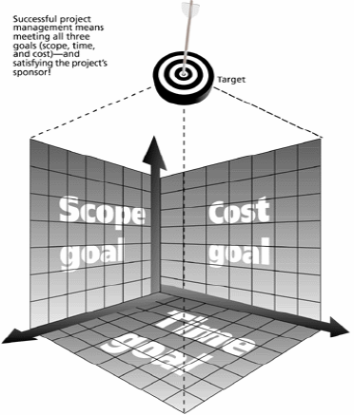
Triple Constraint
Traditional Project Management Constraints
Every project has 3 constrains Scope goals: What work will be done? Time goals: How long should it take to complete? Cost goals: What should it cost?
Scope
Time
Cost

Slide 63
Traditional Project Management Constraints
Time constraint may lead to less quality because of ?
less time for analysis,
less time for planning,
less time for reviewing,
less time for checking,
less time for monitoring,
less time for control

Slide 64
Traditional Project Management Constraints
Cost constraint may lead to less quality because of ?
Hiring less skilled people,
Getting less quality resources
Ignoring some customer requirements

Slide 65
Traditional Project Management Constraints
Scope limitations may lead to less quality because of ?
Scope limitations may lead to Ignore some customer requirements shortcuts

Slide 66
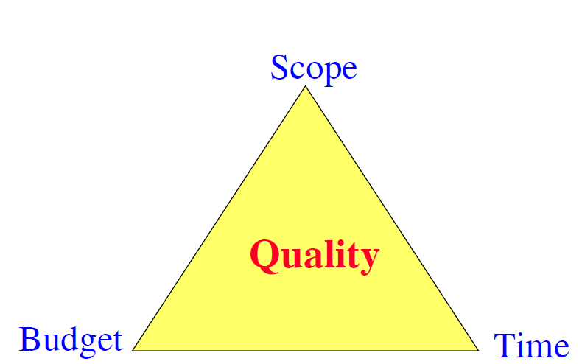
Quadruple Constraint
Traditional Project Management Constraints
Quality is a key factor for projects success We may add Quality as a 4th constraint: The Quadruple constraint =The Triple constraint +Quality constraint
Scope
Quality
Time
Cost
Notes:
Balancing these constraints is critical because changes to one often affect the others.
Increasing the scope might mean additional work is required, leading to higher costs and extended timelines, or it could negatively affect quality if rushed.
Reducing time might pressure the team to complete tasks faster, risking a compromise in quality, unless additional resources (cost) are allocated.
Cutting costs might force the project team to reduce scope or quality to stay within budget, or extend the time to complete the work.

Slide 67
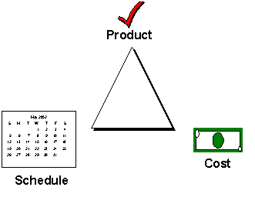
Trade-off Triangle
Fast, cheap, good. Choose two.
Notes:
Fast and Cheap – The project can be completed quickly and at a low cost, but the quality may suffer.
Fast and Good – The project can be completed quickly and to a high standard, but it will likely be expensive due to the resources required.
Cheap and Good – The project can be completed to a high standard without high costs, but it will take longer to complete.

Slide 68
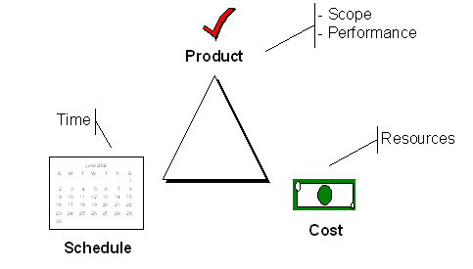
Trade-off Triangle
Know which of these are fixed & variable for every project
Notes:
Fixed time (Fast) means you may have to choose between quality and cost.
Fixed cost (Cheap) means you might have to adjust either the timeline or the quality.
Fixed quality (Good) means you may have to spend more or extend the project timeline
Time
Fixed: If there is a strict deadline (e.g., a product launch date or a critical event), the timeline becomes non-negotiable.
Variable: If delivery time is flexible and the focus is on other aspects like quality or cost, time can be extended as needed.
Cost
Fixed: When the budget is strictly limited (e.g., government projects or low-budget initiatives), the project must work within these financial constraints.
Variable: In cases where quality or scope is more important than staying under budget, costs can increase if needed.
Scope
Fixed: If the deliverables are non-negotiable (e.g., contracts that demand certain features or services), the scope is fixed.
Variable: If the project allows for scope adjustments (e.g., changing features or scaling down the product), the scope can be flexible based on time or cost.
Quality
Fixed: In projects where quality is paramount (e.g., healthcare, aerospace), quality standards cannot be compromised.
Variable: In cases where less critical deliverables are acceptable (e.g., prototypes or MVPs), the quality can be adjusted to meet time and cost constraints.

Slide 69
Four Project Dimensions
People
Process
Product
Technology
Notes:
People manage the process of creating the product using technology.
Effective collaboration between these dimensions ensures the project is delivered on time, within budget, and to the expected quality.
People
This dimension includes all stakeholders involved in the project, such as the project team, clients, users, and management. managing human resources, communication, collaboration, Key activities: Team management, stakeholder engagement, communication, and leadership.
Process
methodologies, workflows, and procedures used to execute the project.
Key activities: Project planning, monitoring, risk management, and implementing best practices (e.g., Agile, Waterfall).
Technology
Technology includes the tools, systems, and infrastructure that support the project. It refers to the software, hardware, and platforms
Key activities: Selecting appropriate tools, ensuring compatibility, and managing technological risks.

Slide 70
People
“It’s always a people problem” Gerald Weinberg, “The Secrets of Consulting”
Developer productivity: 10-to-1 range
Improvements:
Team selection
Team organization
Motivation
Notes:
The "10-to-1 range" in developer productivity refers to the observation that the productivity of software developers can vary dramatically, often by a factor of 10 or more. This means that the most productive developers can sometimes be 10 times more effective than the least productive ones, even when working in the same environment or on similar tasks. Experience and Skill, Problem-Solving Ability, Code Quality and Efficiency, Tool Mastery and Automation, Focus and Concentration, Collaboration and Communication, Adaptability to New Technologies
Team Composition: When building teams, understanding this range is critical. A highly productive developer can significantly boost a project's success, while a poorly performing developer might slow things down. Not Just Lines of Code: Productivity isn't just about writing more code. It’s about writing effective, efficient, and maintainable code.
Mentoring and Support: Providing training and mentorship to less productive developers can help narrow the productivity gap.

Slide 71
People 2
Other success factors
Matching people to tasks
Career development
Balance: individual and team
Clear communication

Slide 72
Process
Is process stifling?
2 Types: Management & Technical
Development fundamentals
Quality assurance
Risk management
Lifecycle planning
Notes:
Process stifling refers to the situation where established processes or procedures become overly rigid, bureaucratic, or complex, leading to reduced productivity, creativity, and morale among team members.
Characteristics of Process Stifling:
Rigidity
Processes are enforced strictly, leaving little room for flexibility or adaptation to unique circumstances or challenges.
Excessive Bureaucracy
A high number of approvals, reviews, and documentation requirements slow down decision-making and action, creating bottlenecks.
Lack of Empowerment
Employees feel disempowered because they must adhere to processes without the ability to make decisions or adjustments based on their expertise or insights.
One-Size-Fits-All Approach
Processes that are applied uniformly across different projects or teams, regardless of specific needs, can hinder effectiveness and adaptability.
Fear of Failure
Teams may become risk-averse, avoiding experimentation and innovation because deviations from the established process are discouraged or penalized.
Consequences of Process Stifling:
Reduced Efficiency
Teams spend more time following cumbersome procedures than focusing on their core work, leading to wasted time and effort.
Decreased Morale and Engagement
Employees may feel frustrated and disengaged when they believe that processes limit their ability to contribute meaningfully or utilize their skills effectively.
Lowered Innovation
A stifling process environment can discourage creative thinking and problem-solving, leading to a lack of new ideas or improvements.
Increased Turnover
High levels of frustration and dissatisfaction can lead to increased employee turnover, resulting in loss of talent and additional hiring costs.
Bottlenecks and Delays
Rigid processes can create bottlenecks that slow down project timelines, leading to missed deadlines and opportunities.
Addressing Process Stifling:
To mitigate process stifling, organizations can:
Encourage Feedback: Regularly solicit input from team members about the effectiveness of current processes and areas for improvement.
Foster a Culture of Flexibility: Allow teams to adapt processes to fit their unique needs, encouraging innovation and creative problem-solving.
Streamline Procedures: Simplify processes by eliminating unnecessary steps, reducing bureaucracy, and focusing on essential actions that drive value.
Implement Agile Methodologies: Consider using agile or iterative approaches that promote flexibility and adaptability, allowing teams to adjust processes based on real-time feedback.

Slide 73
Product
The “tangible” dimension
Product size management
Product characteristics and requirements
Feature creep management
Notes:
Product Size Management refers to the strategies and practices used to effectively control and influence the size, complexity, and scope of a product throughout its lifecycle.
Feature creep management refers to the practices and strategies used to control the gradual expansion of a product's features beyond its original scope. Feature creep can lead to increased complexity, extended timelines, and inflated costs, potentially compromising the product’s quality and effectiveness.

Slide 74
Technology
Often the least important dimension
Language and tool selection
Value and cost of reuse

Slide 75
Classical mistakes
People related
Process related
Product related
Technology related

Slide 76
People Related
Undermined motivation – Studies have shown that giving suspicious talks at the beginning, asking to work overtime reduces the motivation of the people. Sometimes team leaders take long vacations while team is working overnights. The researchers highlighted that team lead has to work along with other team members is a positive motivation.
Weak personnel – If a team need an efficient development throughout the project, the recruitment needs to hire talented developers. Also carefully filter people who could do most of the work until the end of the project.
Uncontrolled problem employees – Failure to take actions for problems with team members and team leads will eventually affect the development speed. Some higher management should actively look into those and sort out.
Heroics – Heroics within the team increases the risk and discourages cooperation among the other members of the team
Adding people to a late project – Adding new people when the project is behind schedule, can take more productivity away from team members.
Notes:
In the context of project management, "heroics" may refer to situations where team members step up to resolve issues, meet deadlines, or overcome significant obstacles, often compensating for inadequate planning or resources. While such efforts can lead to short-term successes, they may not be sustainable or advisable as a regular practice.

Slide 77
Process Related
Overly optimistic schedules – This sort of scheduling will result in failure by under-scoping the project and hurt long-term morale and productivity of the developers.
Insufficient risk management – If projects risks are not actively managed, the project will lead in to slow-development mode.
Contractor failure – weak relationship with contractors can lead to slow-down the project
Insufficient planning
Short-changed upstream activities – Start coding without properly design the project plans will costs 10 or 100 times than doing it with properly designed plans.
Short-changed quality assurance – Eliminating design and code reviews, eliminating test planning and do only perfunctory testing will reduce the development of the project and ends up with major bugs.
Omitting necessary tasks from estimates – People forget about the less visible tasks and those tasks add up.
Code-like-hell programming – Developers should be sufficiently motivated rather forcing them to work hard.

Slide 78
Product Related
Requirements gold-planting – More requirements that are not really necessary, and pay less attention on complex features.
Feature creep – On average 25% of requirements can be changed and affect the project schedule.
Developer gold planting – It is frequent that developers attempt to try new technologies that they saw in other projects, which is not actually necessary.

Slide 79
Technology Related
Silver-bullet syndrome – Thinking that certain approach will solve every issue.
Overestimated savings from new tools or methods – New practices will introduce a new risk as team has to go through a learning-curve to become familiar.
Switching tools in the middle of a project – Using new tools will add a learning curve, rework and inevitable mistakes to project schedule
Lack of automated source-code control – If two or more developers are working on the same part of the project, it is necessary to adhere to source-code control practices. If not developers have to spend time on resolving conflicting changes.

Slide 80
Reading
https://www.wrike.com/project-management-guide/faq/what-is-pmi-in-project-management/
https://www.wrike.com/project-management-guide/faq/what-is-pmbok-in-project-management/%20Inicia%C3%A7%C3%A3o%20etc..pdf
http://www.batimes.com/images/pdfs/The_Ten_Knowledge_Areas_of_PMP.pdf
“Project Management Process Groups, Project Management Skills”, ISBN 978-1-62620-959-6, www.free-management-ebooks.com

Slide 81
References
[1] – Applied Software Project Management By: Jennifer Greene, Andrew Stellman (O'Reilly)
[2] - “Rapid Development”, McConnell (Chapter-3)

